Slide 1
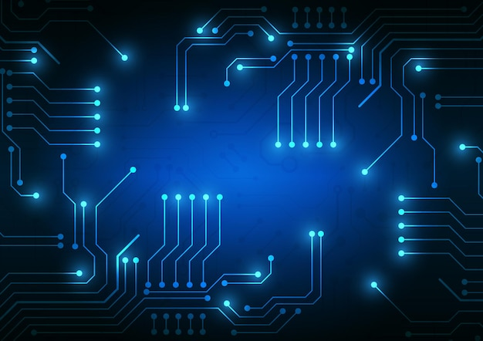
The Role of Controllers
The Role of Controllers
By: Doris Portillo
Doris Portillo

Slide 2

What is a Controller?
A hardware device or software program that manages or directs the flow of data between 2 entities.

Slide 3

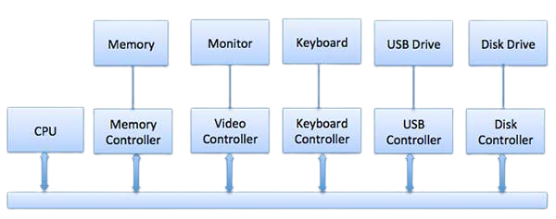

Slide 4

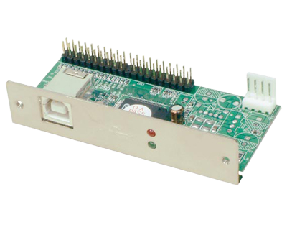
IDE disk or ATA/ATAPI controller
Enables data transfer and storage capability

Slide 5

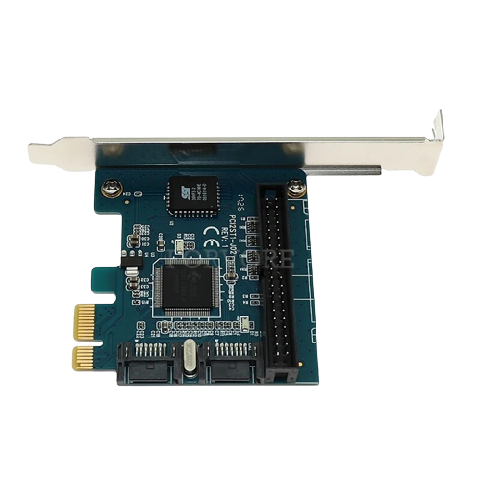
PCI Express
Enables high speed serial communication between CPU and its peripheral devices

Slide 6

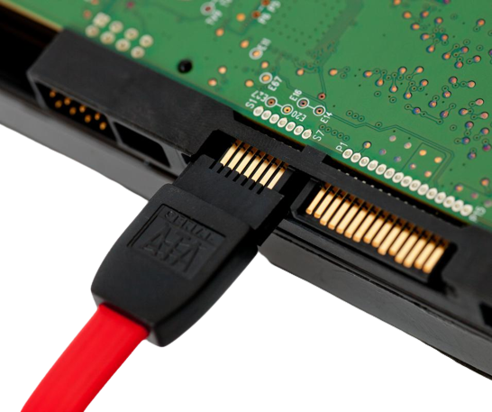
SATA (Serial AT Attachme
SATA (Serial AT Attachment)
How data is transferred between a computers motherboard and mass storage devices

Slide 7
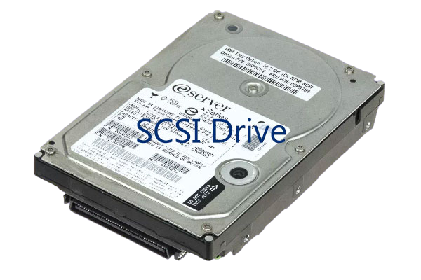
SCSI (small computer system interface)
Used to connect and communicate between computers and peripheral devices

Slide 8

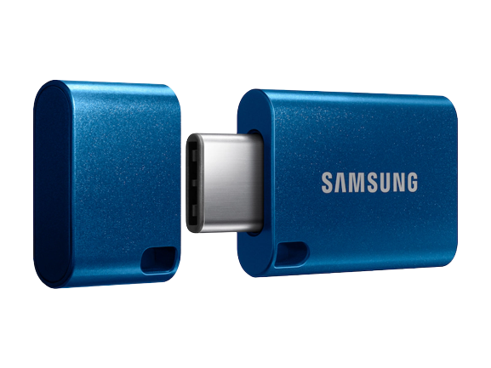
USB (universal serial bus)
A mechanism used to connect peripheral devices to computers and data transfer

Slide 9

What is the role of controllers?
These are responsible for moving the data between the peripheral devices that it controls and its local buffer storage.

Slide 10

Thank you!

